Slide 1
Using Advanced Analytics to Boost Student Success
Dr. Braden J. Hosch, Asst. Vice President for Institutional Research, Planning & Effectiveness, Nov. 11, 2018

Slide 2
Overview
Institutional profile and grad rate improvements
Initiatives
“Traditional” IR / Analytics
Predictive Analytics
Takeaways

Slide 3
Stony Brook University Institutional Profile
Students: 26,254 | Institution: Doctoral, Highest Research Activity Founded 1957, joined AAU 2001
Undergraduate Profile 1323 avg. SAT | Program Profile 7,272 Completions 2017-18
Employees: 14,732 including hospital 2,704 faculty (FT & PT) | Finance: 2.5 billion USD annual budget 230 million USD research exp.
Graduate
Fall headcount
Undergraduate
Pell
Recipients

Slide 4
Freshman graduation rates increased fifteen percentage points in the last five years; equity gaps are largely closed

Slide 5
Improvements realized through multi-pronged approach
Broad-based academic success team
“Traditional” institutional research
In-house analytics
3rd-party analytics
Policy and procedure reform
Mini-grants to seniors
Attention to special populations
Expanded advising
Class availability
Notes:
Special populations:
State scholarship recipients
Juniors and seniors, esp. when behind in credits
Men

Slide 6
Traditional IR - grad rates by DFW rates
Number of 1st Term Course Grades of D, F, W or U
Source: IRPE Grad Rate data set v31; cohort entering 2014

Slide 7
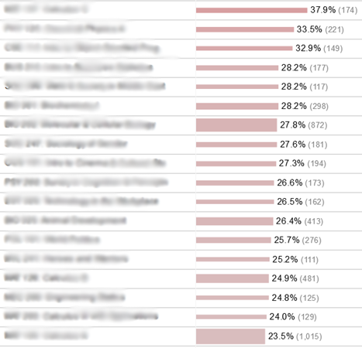
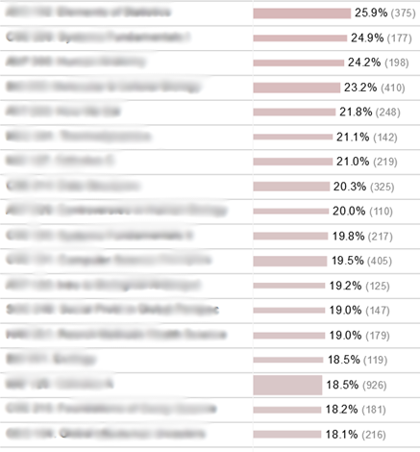
Address Courses with Higher DFW Rates
Top 18 Fall 2010 courses
23.5%-37.9%
Top 18 Fall 2017 courses
18.1%-25.9%

Slide 8
Exploratory IR – number of course grades of A
Number of 1st Term Course Grades of A or A-
Source: IRPE Grad Rate data set v31; cohort entering 2014

Slide 9
Method for local analytics: student-level predictions
Credit to: Nora Galambos, Ph.D., Senior Data Scientist
Decision trees using SAS Enterprise Miner
Classification and Regression Trees (CART) method
Clustering to reduce multi-collinearity
Imputation of some but not all missing values
Data partitioned into training, test, and validation sets

Slide 10
Data included in model
Demographics
Gender
Pre-college academic characteristics
SAT scores
College academic characteristics
Credits accepted when admitted
Transactions, service utilization, activities.
Learning management system (LMS) logins
Financial aid
Expected family contribution AGI
AP credits
number of STEM and non-STEM courses current term
enrollment in high DFW courses
area of major.
high school GPA
average SAT scores of the high school (to control for high school GPA).
geographic residence when admitted.
Race/ethnicity
advising visits
tutoring center utilization
intramural and fitness class participation
types and amounts of disbursed aid
Pell, Tuition Assistance Program (TAP).

Slide 11
LMS Data Processing
Count only one login per course per hour
A course can have up to 24 logins per day
Eliminates multiple logins just few minutes apart.
Logins totaled by week
Per-course login rates calculated for STEM and non-STEM courses
Class assignment grades not yet included
Timing and data processing issues
Completeness issues
Significant noise and false positives

Slide 12
Decision Tree Model for Freshmen GPA: Part 1—HS GPA <= 92.0
HS GPA<=92.0
LMS logins per non-STEM crs, wk 2-6 >=11.3 or missing
SAT Math CR >1360
AP STEM Crs>=1
Avg. GPA = 3.63
N = 46
AP Stem Crs = 0
Avg. GPA = 3.20
N = 23
SAT Math CR <=1360
Highest DFW STEM Crs. Rate>= 17%
Avg. GPA = 2.92
N= 34
Highest DFW STEM Crs. Rate <17%
Avg. GPA = 3.25
N=94
Avg. HS SAT CR<=570
Logins per STEM crs, wk 2-6 >=32.2
SAT Math >=680
Avg. GPA = 3.35
N=78
SAT Math<680 or miss.
Avg. GPA = 3.09
N = 121
Logins per STEM crs, wk 2-6 <32.2
Non-STEM crs logs > = 3 or miss.
Avg. GPA = 2.53
N = 57
AP STEM Crs. >=1
STEM crs logs Wk. 1>=5 or miss.
Avg. GPA = 3.21
N = 64
STEM crs logs
Wk 1 < 5
Avg. GPA = 2.69
N=16
AP STEM Crs = 0
STEM logs Wk. 1 >=5 or miss.
Avg. GPA = 2.75
N = 73
STEM crs logs Wk. 1 <5
Avg. GPA = 2.12
N= 18
Avg. HS SAT CR < 540
Logs per STEM crs, wk 2-6 >=5.3 or miss
STEM crs logs Wk 1 >=1 or miss.
Avg. GPA = 2.62
N = 305
STEM crs kogs Wk 1 = 0
Avg. GPA = 1.94
N = 25
Logs per STEM crs. wk 2-6 < 5.3
Avg. GPA = 1.59
N = 13
Avg. HS SAT CR >570
Avg. GPA = 2.94
N = 371
LMS logins per non-STEM crs, wks 2-6<11.3
Non-STEM crs logins <3
Avg. HS SAT CR >=540

Slide 13
Decision Tree Model for F14 Freshmen GPA: Part 2—HS GPA > 92.0
Decision Tree Model for F14 Freshmen GPA: Part 2—HS GPA > 92.0
HS GPA>92.0 or Missing
Scholarship = Yes
Math Placement Exam >= 5
Logs per STEM Crs., wks 2-6 >=15.6
Avg. GPA = 3.63 N = 285
Logs per STEM Crs, wk 2-6 <15.6
Avg. GPA 3.40
N = 83
Math Placement Exam < 5
Ethnic Group = White, Hisp.
Avg. GPA =3.50
N= 73
Ethnic Group=Asian, Afr. Amer., Unk.
Avg. GPA = 3.05
N=30
HS GPA < 96.5
Logs per non-STEM crs,wks 2-6 >=29.1
SAT Math>=700
Avg. GPA = 3.76 N=26
SAT Math<700 or miss.
Avg. GPA = 3.52
N = 74
Logs per non-STEM crs,wks 2-6 <29.1
Avg HS. CR, M Wrt >=1830 miss
Avg. GPA = 3.13
N = 54
AP STEM Crs. >=1
DFW STEM Crs Total >=2
Avg. GPA = 3.23
N = 163
DFW STEM Crs Total <2
Avg. GPA = 3.49
N=101
AP STEM Crs = 0
SAT Math >=760
Avg. GPA = 3.76
N = 11
SAT Math <760
Avg. GPA = 3.03
N= 194
LMS logins per non-STEM crs. wk 2-6 < 10.4
Logs per STEM crs, wks 2-6 >=10.9 or miss.
DFW non-STEM 1st yrs >=28%
Avg. GPA = 3.05
N = 72
DFW non-STEM 1st yrs <28%
Avg. GPA = 2.90
N = 73
Logs per STEM crs. wks 2 6 < 10.9
Avg. GPA = 2.52
N = 16
HS GPA >=96.5 or missing
Avg. GPA = 3.59
N = 54
Scholarship = No
Avg. HS CR, M, Wrt< 1830
LMS logins per non-STEM crs. Wk 2-6 >=10.4
Avg. GPA= 1.30 N=11
STEM Crs logs Wk 1 <8 or miss
STEM Crs logs Wk 1 >=8

Slide 14
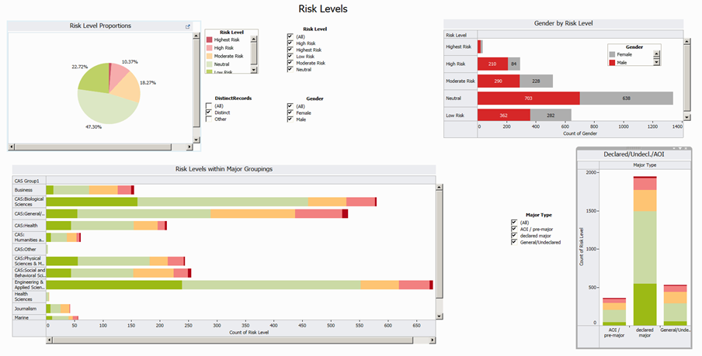
Analytics dashboard

Slide 15
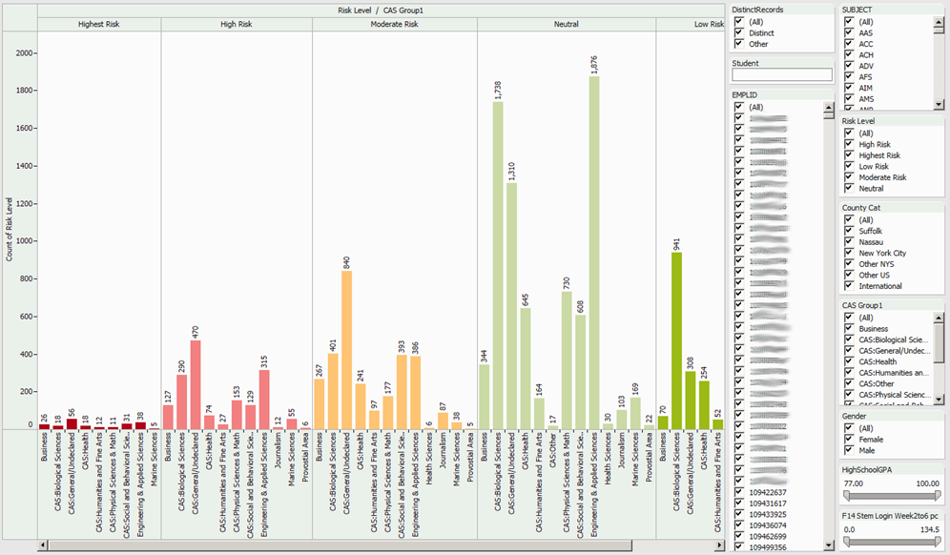
Population monitoring and drill to detail
Search for a student’s name or choose an ID
Double click on a bar to drill down to students records
HS GPA and LMS login sliders

Slide 16
Final thoughts
Selected Technical considerations
Information delivery
Data quality/governance
False positives/negatives
***Use of analytics is not just technical***
Culture change
Trust
Ethics

